Slide 1
Decidability
CSC3113: Theory of Computation
18
11
Summer 2020-2021
Sharfuddin Mahmood, Assistant Professor,
Department of Computer Science, Faculty of Science & Technology.
smahmood@aiub.edu

Slide 2
Decidable Language
Algorithmic Solvability
Representation of TM for decidable language
Decidable Problems
Regular Language
Context-Free Language
Nondeterministic TM and Turing-Recognizable
Classes of Languages

Slide 3
Decidable Language
So far, we have learned
Turing machine as a model of a general-purpose computing device.
Defined the notion of algorithm in terms of Turing machines by means of the Church–Turing thesis.
Now, we investigate the power of algorithms to solve problems by showing certain problems that can be solved algorithmically and others that cannot.
Our objective is to explore the limits of algorithmic solvability.

Slide 4
All outcome are represented with examples
Understand the power of algorithms to solve problems by showing certain problems that can be solved algorithmically.
Use of TM with algorithms to decide on regular and context-free languages.
Turing decidable vs Turing recognizable
Classes of Languages

Slide 5
Algorithmic Solvability
We are familiar with solvability by algorithms because much of computer science is devoted to solving problems.
Any problem, if solvable by an algorithm, must be decidable (and/or recognizable) by Turing Machine.
We will test some languages that are decidable by some algorithms.
This will be done using the Turing machine.
We will use the high-level description terminology, that we have set in the last lecture.
Representation independence:
Computability (i.e., decidability and recognizability) is not affected by the choice of encoding.
A TM can always convert between different encodings.
We consider 〈 〉 to mean “any reasonable encoding”.

Slide 6
High level description for TM (repeat)
Input Conventions
The input to a Turing machine is always a string.
If we want to provide an object other than a string as input, we must first represent that object as a string.
Strings can easily represent polynomials, graphs, grammars, automata, and any combination of those objects.
A Turing machine may be programmed to decode the representation so that it can be interpreted in the way we intend.
Our notation for the encoding of an object O into its representation as a string is 〈O〉.
If we have several objects O₁, O₂, . . . , O_{k}, we denote their encoding into a single string 〈O₁, O₂, . . . , O_{k}〉.
The encoding itself can be done in many reasonable ways. It doesn’t matter which one we pick because a Turing machine can always translate one such encoding into another.

Slide 7
High level description for TM (repeat)
TM Algorithms
Turing machine algorithms are given with an indented segment of text within quotes.
We break the algorithm into stages, each usually involving many individual steps of the Turing machine’s computation.
We indicate the block structure of the algorithm with further indentation.
The first line of the algorithm always describes the input to the machine. If the input description is simply string w, the input is taken to be a string. If the input description is the encoding of an object as in 〈O〉, the Turing machine first implicitly tests whether the input properly encodes an object of the desired form and rejects it if it doesn’t.

Slide 8
DECIDABLE PROBLEMS: REGULAR LANGUAGES
The problem of testing whether a DFA B accepts an input w is the same as the problem of testing whether 〈B, w〉 is a member of the language A_{DFA}.
A_{DFA} = { 〈B, w〉 | B is a DFA that accepts string w }
Showing that the language is decidable is the same as showing that the computational problem is decidable.
Following is a TM M that decides A_{DFA}.
M = “On input 〈B, w〉, where B is a DFA and w is a string:
Simulate B on input w.
If the simulation ends in an accept state, ACCEPT. If it ends in a nonaccepting state, REJECT.”

Slide 9
DECIDABLE PROBLEMS: REGULAR LANGUAGES
A_{DFA} = { 〈A, w〉 | A is a DFA that accepts string w }
Following is a TM M that decides A_{DFA}.
M = “On input 〈A, w〉, where A is a DFA and w is a string:
Simulate A on input w.
If the simulation ends in an accept state, ACCEPT. If it ends in a nonaccepting state, REJECT.”
Step 1, simulation idea:
〈A, w〉 is input where, A=(Q, Σ, δ, q₀, F) and w is the input string.
All the five tuples can be represented as string in the tape of TM M.
M simulates w specified by the transition function δ starting with q₀. Multiple tapes may be used to simulate w.
Keeps track of the current state, looks for the current input pointed by the head of M on the tape, matches with the transition function δ, and finally moves to the next state and points head to the next input symbol.
When M finishes processing the last symbol of w, M accepts the input if A is in an accepting state; M rejects the input if A is in a nonaccepting state.

Slide 10
DECIDABLE PROBLEMS: REGULAR LANGUAGES
A_{NFA} = { 〈B, w〉 | B is an NFA that accepts string w }
Following is a TM N that decides A_{NFA}.
N = “On input 〈B, w〉, where B is an NFA and w is a string:
Convert NFA B to an equivalent DFA A using formal procedure
Let, TM M that decides A_{DFA}. Run TM M on input 〈A, w〉.
If M accepts then, ACCEPT; otherwise, REJECT.”
Idea: The conversion in step 1 can easily be done in a 2-tape TM, where tape one contains the five tuples of NFA and tape two is filled up by computing the tuples for equivalent DFA from tape 1, based on the formulations provided by the conversion procedure.

Slide 11
DECIDABLE PROBLEMS: REGULAR LANGUAGES
A_{REX} = { 〈C, w〉 | C is a Regular Expression that generates string w }
Following is a TM R that decides A_{NFA}.
R = “On input 〈C, w〉, where C is a Regular Expression and w is a string:
Convert Regular Expression C to an equivalent NFA B using formal procedure.
Let, TM N that decides A_{NFA}. Run TM N on input 〈B, w〉.
If N accepts then, ACCEPT; otherwise, REJECT.”
Idea: The conversion in step 1 can easily be done in a 2-tape TM, where tape one contains the regular expression and tape two is filled up by computing the tuples for equivalent NFA from tape 1, based on the precedence order of the regular operations and formulations provided by the conversion procedure.

Slide 12
DECIDABLE PROBLEMS: REGULAR LANGUAGES
Emptiness Testing for DFA
E_{DFA} = {⟨A⟩ | A is a DFA with L(A) = ∅ }
Following is a TM T that decides E_{DFA}.
T = “On input 〈A〉, where A is a DFA:
Write A (all tuples as string) in tape 1; If A is invalid, REJECT.
Mark X the start state of A from tape 1 and write it to the tape 2.
Repeat until no new states get written on tape 2:
Mark X any state (from tape 1) that has a transition (specified by δ in tape 1) coming into it from any state that is already written in tape 2 and Write this marked state to tape 2.
If no accept state is in tape 2, (i.e. {set of unmarked states in tape 1} ∩{set of states in tape 2} = ∅) ACCEPT; otherwise, REJECT.”

Slide 13
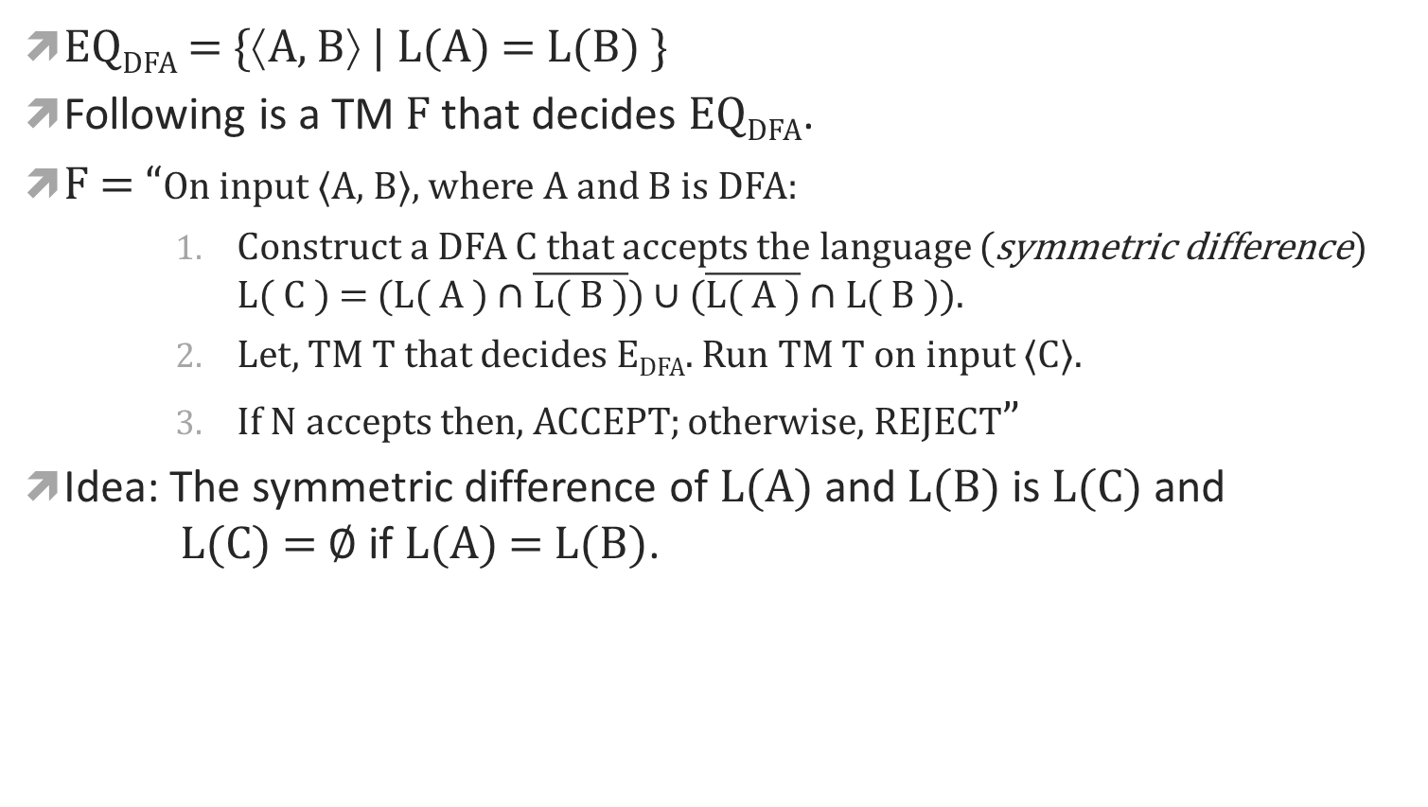
DECIDABLE PROBLEMS: REGULAR LANGUAGES
DFA Equivalence
EQ_{DFA} = {⟨A, B⟩ | L(A) = L(B) }
Following is a TM F that decides EQ_{DFA}.
F = “On input 〈A, B〉, where A and B is DFA:
Construct a DFA C that accepts the language (symmetric difference) $\text{L}\text{( }\text{C}\text{ ) = (}\text{L}\text{( }\text{A}\text{ ) ∩ }\overline{\text{L}\text{( }\text{B}\text{ )}}\text{) }\text{∪} \text{(}\overline{\text{L}\text{( }\text{A}\text{ )}} \text{∩ }\text{L}\text{( }\text{B}\text{ ))}$.
Let, TM T that decides E_{DFA}. Run TM T on input 〈C〉.
If N accepts then, ACCEPT; otherwise, REJECT”
Idea: The symmetric difference of L(A) and L(B) is L(C) and L(C) = ∅ if L(A) = L(B).

Slide 14
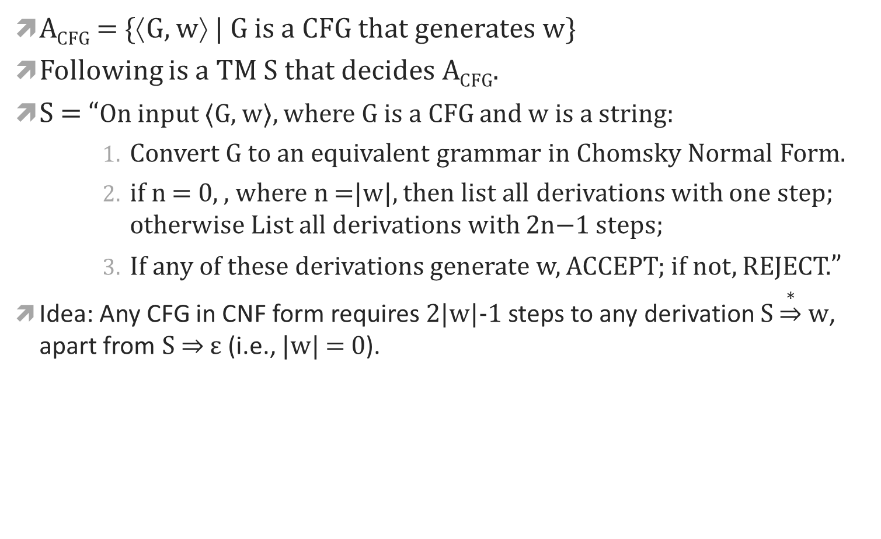
DECIDABLE PROBLEMS: CFL
A_{CFG} = {⟨G, w⟩ | G is a CFG that generates w}
Following is a TM S that decides A_{CFG}.
S = “On input 〈G, w〉, where G is a CFG and w is a string:
Convert G to an equivalent grammar in Chomsky Normal Form.
if n = 0, , where n =|w|, then list all derivations with one step; otherwise List all derivations with 2n−1 steps;
If any of these derivations generate w, ACCEPT; if not, REJECT.”
Idea: Any CFG in CNF form requires 2|w|-1 steps to any derivation $S\underset{⇒}{∗}w$, apart from S ⇒ ε (i.e., |w| = 0).

Slide 15
DECIDABLE PROBLEMS: CFL
E_{CFG} = {⟨G⟩ | G is a CFG and L(G) = ∅}
Following is a TM R that decides E_{CFG}.
R = “On input ⟨G⟩, where G is a CFG:
Write the input as string in tape 1
Mark X all terminal symbols in tape 1 and write them in tape 2.
Repeat until no new variables get marked X:
Mark X any variable A in tape 1 where, G has a rule A → U₁U₂ · · ·U_{k} and each symbol U₁, . . . , U_{k} is already in tape 2.
If the start variable is not marked (not in tape 2), ACCEPT; otherwise, REJECT.”
Idea: In order to determine whether the language of a grammar is empty, we need to test whether the start variable can generate a string of terminals. The algorithm does so by determining for each variable whether that variable is capable of generating a string of terminals.

Slide 16
Nondeterministic PDAs
One of the idea to test if a CFG A is decidable or not, is to convert the PDA for A directly into a TM. This can be done as simulating a stack with the TM’s tape is easy.
If the PDA for A is nondeterministic, that can be convert into a nondeterministic TM and that nondeterministic TM can be converted into an equivalent deterministic TM.
Yet, there is a difficulty. Some branches of the such PDA’s computation may go on forever, reading and writing the stack without ever halting.
The simulating TM then would also have some non-halting branches in its computation, and so the TM would not be a decider.
It would be a TM recognizer. One of such example is – EQ_{CFG} = {⟨G, H⟩ | G and H are CFGs and L(G) = L(H)} because CFGs are not closed under complementation or intersection.

Slide 17
Classes of Languages
TURING RECOGNIZABLE
DECIDABLE
CONTEXT-FREE
REGULAR

Slide 18
Decidability & Recognizable
Introduction to Theory of Computation, Sipser, (3rd ed), Decidability and Exercises.

